Slide 1
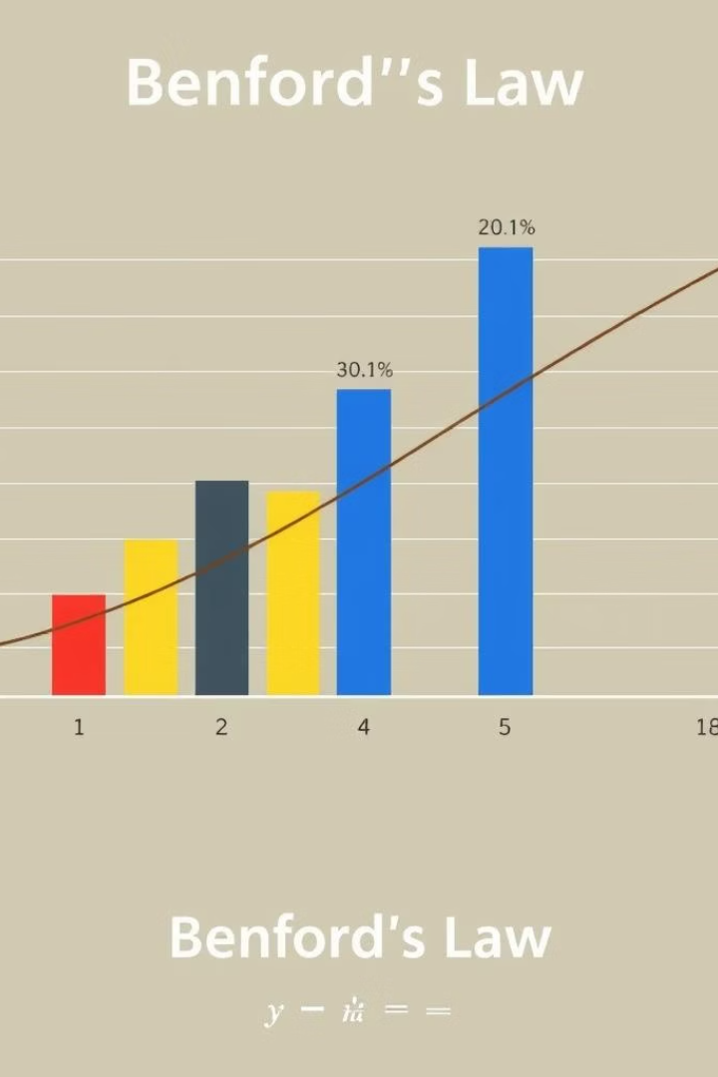
Benford’s Law Application in Twitter Dataset Analysis
TEAM - WJD.AI
Presented by Data Diggers: Chiranjeev Agarwal, Sahil Khan, Sumit Kumar, and Harshit Gupta.

Slide 2
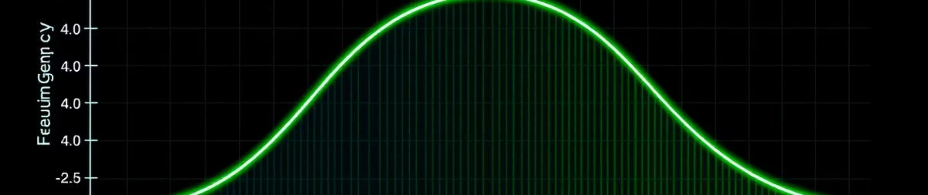
Introduction to Benford’s Law
Definition
Digit Distribution
Pattern
Benford's Law governs leading digit frequency in datasets.
Smaller digits (1, 2, 3) appear more often than larger (7, 8, 9).
Distribution follows a logarithmic scale.

Slide 3




Importance and Applications
Fraud Detection
Data Validation
Uncover manipulated or fabricated data.
Verify dataset integrity and natural patterns.
Risk Analysis
Spot anomalies in large datasets.

Slide 4
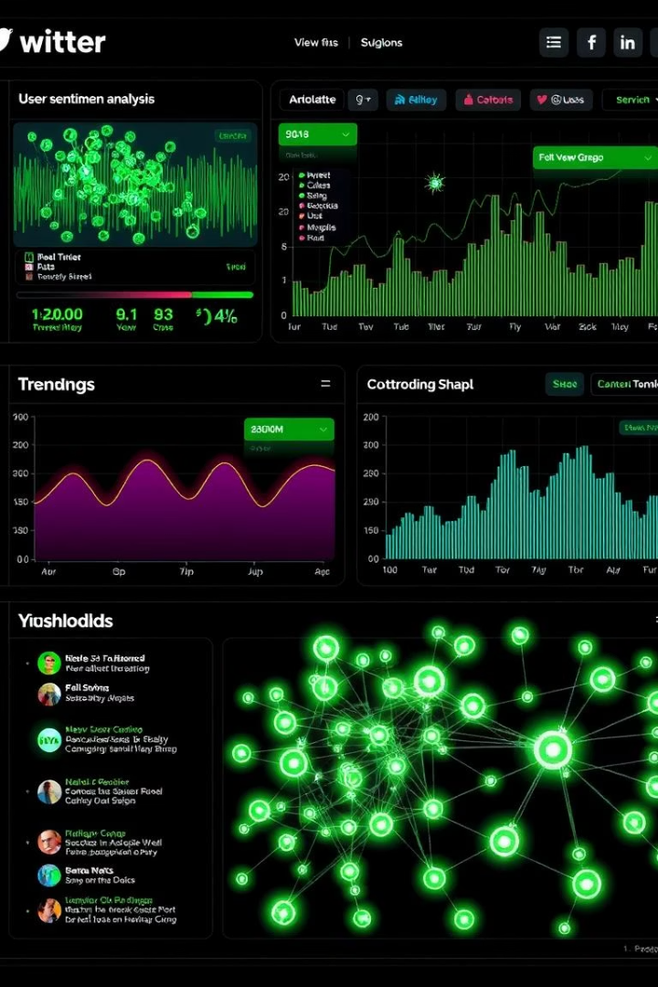
Project Overview
Theory Exploration
Study Benford’s Law fundamentals.
Real Dataset Application
Analyze Twitter's 'friends' count data.
Visualization
Compare expected vs. actual distributions.
Discussion
Interpret findings and implications.

Slide 5
Dataset Description
Dataset
Column Analyzed
Preprocessing
Public Twitter dataset containing user profiles.
'friends' count representing user connections.
Cleaned for numeric consistency and parsed properly.

Slide 6





Tools and Technologies
pandas
numpy
matplotlib & seaborn
Data handling and manipulation
Numerical analysis capabilities
Visualization libraries
scipy.stats
Chi-square statistical testing
Also used AST library for safe string evaluation.

Slide 7







Methodology
Import Dataset
Load CSV data into analysis environment.
Clean Data
Handle nulls and parse numeric values.
Extract Leading Digit
Analyze first digits (1-9) of 'friends' counts.
Frequency Calculation
Count observed digit appearances.
Compute Expected
Calculate expected frequencies via Benford’s Law.
Visualization
Chart observed vs. expected frequencies.
Statistical Testing
Perform chi-square test for conformity.

Slide 8
Results and Discussion
Findings
Conclusion
General adherence to Benford’s Law.
Twitter 'friends' data mostly conforms to expected distribution.
Minor deviations linked to platform behavior.
Benford analysis is effective for social media metrics.

Slide 9
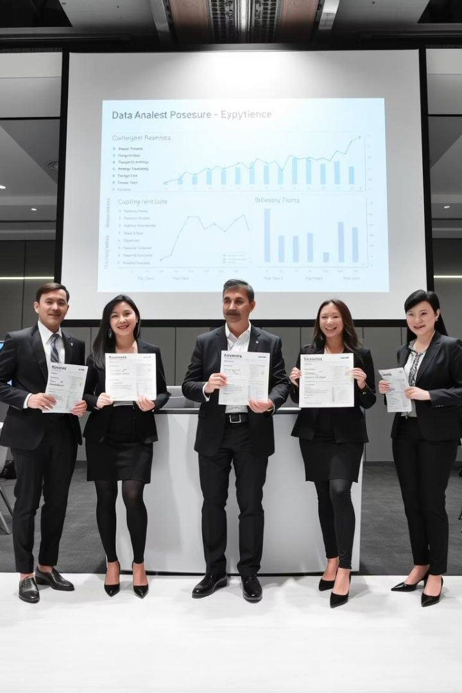
Individual Contributions
Harshit Gupta
1
Performed initial data exploration and preprocessing steps.
2
Sumit Kumar
Led Benford’s Law analysis and created chi-square test plots.
Sahil Khan
3
Prepared and designed the final presentation slides.
4
Chiranjeev Agarwal
Developed visualizations and extracted insights from data plots.

